Slide 1
Fault Tolerance
Chapter 8
Part I Introduction
Part II Process Resilience
Part III Reliable Communication
Part IV Distributed Commit
Part V Recovery

Slide 2
Giving credit where credit is due:
CSCE455/855 Distributed Operating Systems
Most of the lecture notes are based on slides by Prof. Jalal Y. Kawash at Univ. of Calgary and Dr. Daniel M. Zimmerman at CALTECH
Some of the lecture notes are based on slides by Scott Shenker and Ion Stoica at Univ.of California, Berkeley, Timo Alanko at Univ. of Helsinki, Finland, Hugh C. Lauer at Worcester Polytechnic Institute, Xiuwen Liu at Florida State University
I have modified them and added new slides

Slide 3
Fault Tolerance
Chapter 8
Part I
Introduction

Slide 4
Fault Tolerance
A DS should be fault-tolerant
Should be able to continue functioning in the presence of faults
Fault tolerance is related to dependability

Slide 5
Dependability
Dependability Includes
Availability
Reliability
Safety
Maintainability

Slide 6
Availability & Reliability (1)
Availability: A measurement of whether a system is ready to be used immediately
System is up and running at any given moment
Reliability: A measurement of whether a system can run continuously without failure
System continues to function for a long period of time

Slide 7
Availability & Reliability (2)
A system goes down 1ms/hr has an availability of more than 99.99%, but is unreliable
A system that never crashes but is shut down for a week once every year is 100% reliable but only 98% available

Slide 8
Safety & Maintainability
Safety: A measurement of how safe failures are
System fails, nothing serious happens
For instance, high degree of safety is required for systems controlling nuclear power plants
Maintainability: A measurement of how easy it is to repair a system
A highly maintainable system may also show a high degree of availability
Failures can be detected and repaired automatically? Self-healing systems?

Slide 9
Faults
A system fails when it cannot meet its promises (specifications)
An error is part of a system state that may lead to a failure
A fault is the cause of the error
Fault-Tolerance: the system can provide services even in the presence of faults
Faults can be:
Transient (appear once and disappear)
Intermittent (appear-disappear-reappear behavior)
A loose contact on a connector ➔intermittent fault
Permanent (appear and persist until repaired)

Slide 10
Failure Models
Type of failure | Description
Crash failure | A server halts, but is working correctly until it halts
Omission failure Receive omission Send omission | A server fails to respond to incoming requests A server fails to receive incoming messages A server fails to send messages
Timing failure | A server's response lies outside the specified time interval
Response failure Value failure State transition failure | The server's response is incorrect The value of the response is wrong The server deviates from the correct flow of control
Arbitrary failure (Byzantine failure) | A server may produce arbitrary responses at arbitrary times

Slide 11
Failure Masking
?
Redundancy is key technique for hiding failures
Redundancy types:
Information: add extra (control) information
Error-correction codes in messages
Time: perform an action persistently until it succeeds:
Transactions
Physical: add extra components (S/W & H/W)
Process replication, electronic circuits

Slide 12
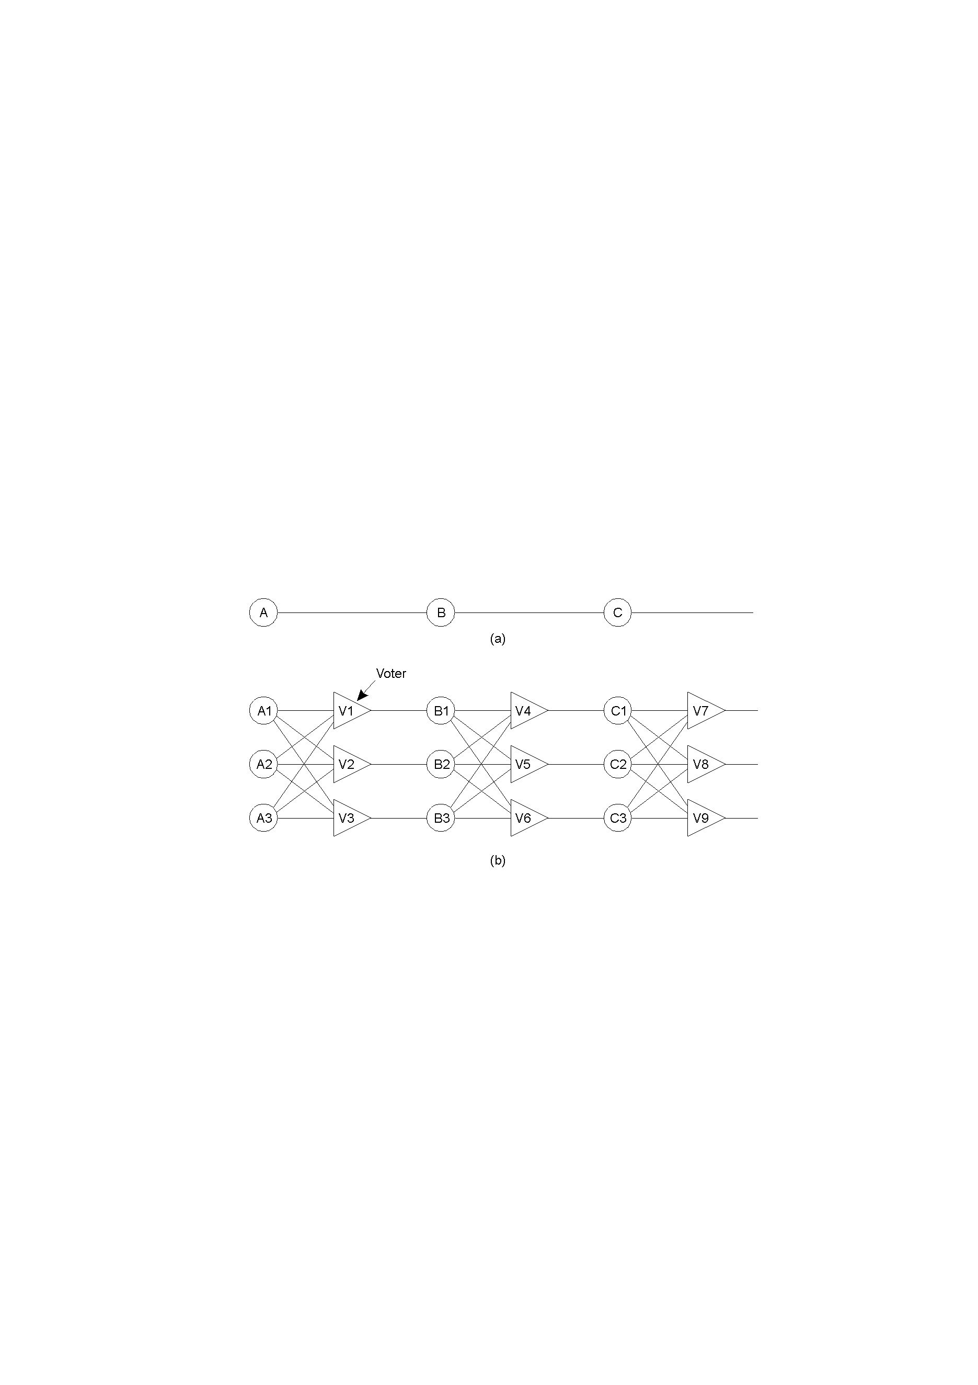
Example – Redundancy in Circuits (1)

Slide 13
Example – Redundancy in Circuits (2)
Triple modular redundancy.

Slide 14
Fault Tolerance
Chapter 8
Part II
Process Resilience

Slide 15
Process Resilience
Mask process failures by replication
Organize processes into groups, a message sent to a group is delivered to all members
If a member fails, another should fill in

Slide 16
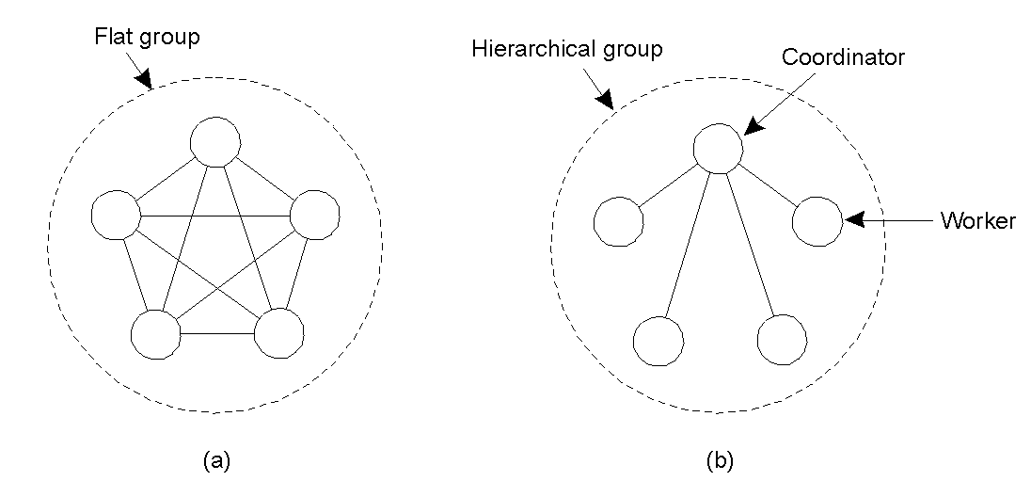
Flat Groups versus Hierarchical Groups
Communication in a flat group.
Communication in a simple hierarchical group

Slide 17
Process Replication
Replicate a process and group replicas in one group
How many replicas do we create?
A system is k fault-tolerant if it can survive and function even if it has k faulty processes
For crash failures (a faulty process halts, but is working correctly until it halts)
k+1 replicas
For Byzantine failures (a faulty process may produce arbitrary responses at arbitrary times)
2k+1 replicas

Slide 18
Agreement
Need agreement in DS:
Leader, commit, synchronize
Distributed Agreement algorithm: all non-faulty processes achieve consensus in a finite number of steps
Perfect processes, faulty channels: two-army
Faulty processes, perfect channels: Byzantine generals

Slide 19
Two-Army Problem
Notes:
In this example, Enemy Red Army has 5000 troops. Blue Army has two separate gatherings, Blue (1) and Blue (2), each of 3000 troops. Alone Blue will loose, together as a coordinated attack Blue can win. Communications is by unreliable channel (send a messenger who may be captured by red army so may not arrive.

Slide 20
Byzantine Generals Problem





Slide 21
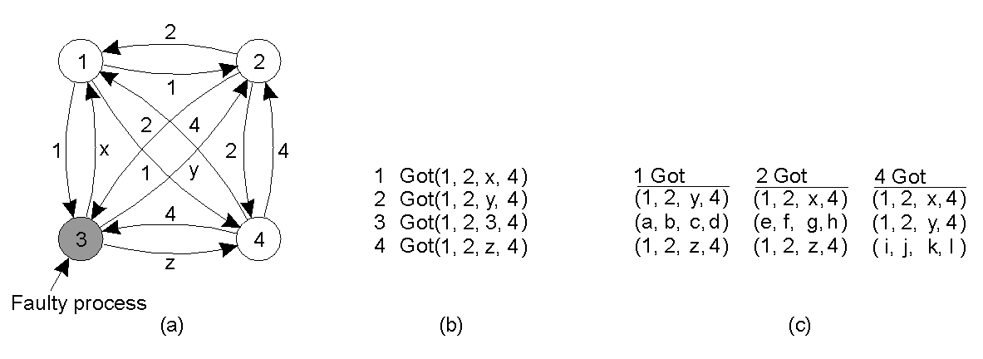
Byzantine Generals -Example (1)
The Byzantine generals problem for 3 loyal generals and1 traitor.
The generals announce the time to launch the attack (by messages marked by their ids).
The vectors that each general assembles based on (a)
The vectors that each general receives in step 3, where every general passes his vector from (b) to every other general.

Slide 22
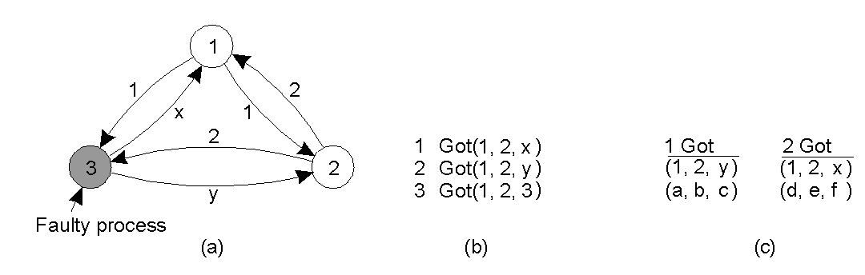
Byzantine Generals –Example (2)
The same as in previous slide, except now with 2 loyal generals and one traitor.

Slide 23
Byzantine Generals
Given three processes, if one fails, consensus is impossible
Given N processes, if F processes fail, consensus is impossible if N ≤ 3F

Slide 24

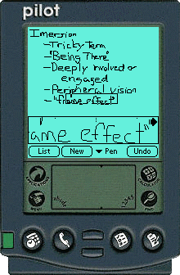
OceanStore Global-Scale Persistent Storage on Untrusted Infrastructure

Slide 25
Update Model
Concurrent updates w/o wide-area locking
Conflict resolution
Updates Serialization
A master replica?
Incompatible with the untrusted infrastructure assumption
Role of primary tier of replicas
All updates submitted to primary tier of replicas which chooses a final total order by following Byzantine agreement protocol
A secondary tier of replicas
the result of the updates is multicast down the dissemination tree to all the secondary replicas

Slide 26

The Path of an OceanStore Update

Slide 27
Fault Tolerance
Chapter 8
Part III
Reliable Communication

Slide 28
Reliable Group Communication

Slide 29
Reliable Group Communication
When a group is static and processes do not fail
Reliable communication = deliver the message to all group members
Any order delivery
Ordered delivery

Slide 30
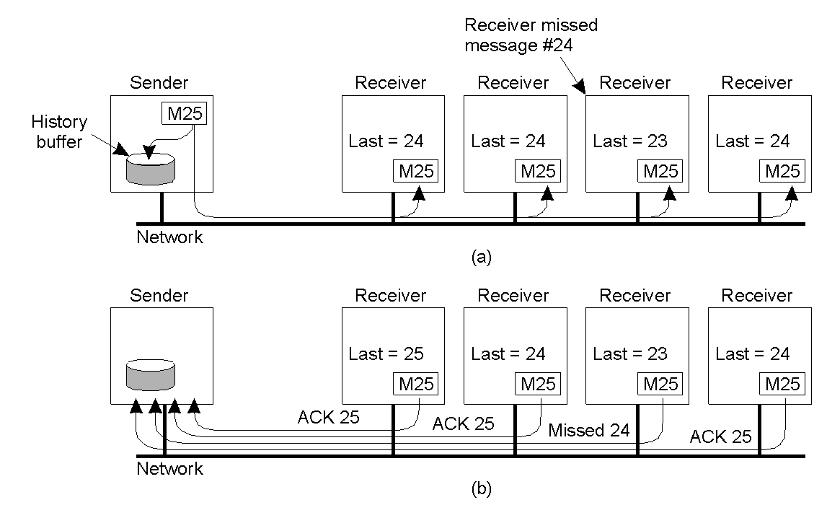
Basic Reliable-Multicasting Schemes
A simple solution to reliable multicasting when all receivers are known and assumed not to fail
Message transmission
Reporting feedback

Slide 31
Atomic Multicast
All messages are delivered in the same order to “all” processes
Group view: the view on the set of processes contained in the group
Virtual synchronous multicast: a message m multicast to a group view G is delivered to all non-faulty processes in G

Slide 32
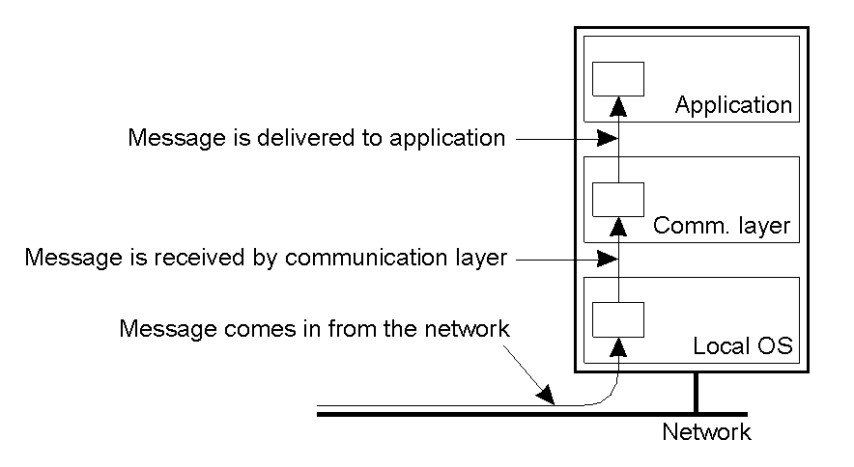
Virtual Synchrony System Model
The logical organization of a distributed system to distinguish between message receipt and message delivery

Slide 33
Message Delivery
Application
Delivery of messages
new message => HBQ
decision making
delivery order
deliver or not to deliver?
the message is allowed to be
delivered: HBQ => DQ
when at the head of DQ:
message => application
(application: receive …)
delivery
hold-back queue
delivery queue
Message passing system

Slide 34
Virtual Synchronous Multicast
a) Message is not delivered
b) Message is delivered
A
A
B
B
C
C
G_{i} = (A, B, C)
G_{i+1} = (B, C)
G_{i} = (A, B, C)
G_{i+1} = (B, C)

Slide 35
Virtual Synchronous Multicast
a) Message is not delivered
b) ???
A
A
B
B
C
C
G_{i} = (A, B, C)
G_{i+1} = (B, C)
G_{i} = (A, B, C)
G_{i+1} = (B, C)

Slide 36
Virtual Synchronous Multicast
a) ???
A
B
C
G_{i} = (A, B, C)
G_{i+1} = (B, C)

Slide 37
Reliability of Group Communication?
A sent message is received by all members
(acks from all => ok)
Problem: during a multicast operation
an old member disappears from the group
a new member joins the group
Solution
membership changes synchronize multicasting
during a MC operation no membership changes
Virtual synchrony: “all” processes see message and membership change in the same order

Slide 38
Virtual Synchronous Multicast
a) Message is not delivered
b) Message is delivered
A
A
B
B
C
C
G_{i} = (A, B, C)
G_{i+1} = (B, C)
G_{i} = (A, B, C)
G_{i+1} = (B, C)

Slide 39
Virtual Synchrony Implementation: [Birman et al., 1991]
Only stable messages are delivered
Stable message: a message received by all processes in the message’s group view
Assumptions (can be ensured by using TCP):
Point-to-point communication is reliable
Point-to-point communication ensures FIFO-ordering
How to determine if a message is stable?

Slide 40
Virtual Synchrony Implementation: Example
G_{i} = {P1, P2, P3, P4, P5}
P5 fails
P1 detects that P5 has failed
P1 send a “view change” message to every process in G_{i+1} = {P1, P2, P3, P4}
P2
P3
P1
change view
P4
P5

Slide 41
Virtual Synchrony Implementation: Example
Every process
Send each unstable message m from G_{i} to members in G_{i+1}
Marks m as being stable
Send a flush message to mark that all unstable messages have been sent
unstable message
P2
P3
P1
flush
message
P4
P5

Slide 42
Virtual Synchrony Implementation: Example
Every process
After receiving a flush message from all processes in G_{i+1} installs G_{i+1}
P2
P3
P1
P4
P5

Slide 43
Announcement
2nd Midterm in the week after Spring Break
March 27, Wednesday
Chapters 6, 7, 8.1, & 8.2

Slide 44
Distributed Commit
Goal: Either all members of a group decide to perform an operation, or none of them perform the operation
Atomic transaction: a transaction that happens completely or not at all

Slide 45
Assumptions
Failures:
Crash failures that can be recovered
Communication failures detectable by timeouts
Notes:
Commit requires a set of processes to agree…
…similar to the Byzantine generals problem…
… but the solution much simpler because stronger assumptions

Slide 46
Distributed Transactions
client
ser-ver
Database
atomic
ser-ver
Atomic
Consistent
Isolated
Durable
isolated
serializable
ser-ver
Database
client

Slide 47
A Distributed Banking Transaction
openTransaction
join
participant
closeTransaction
.
A
a.withdraw(4);
.
join
BranchX
T
participant
Client
B
b.withdraw(3);
T =
openTransaction
BranchY
a.withdraw(4);
join
c.deposit(4);
participant
b.withdraw(3);
d.deposit(3);
C
c.deposit(4);
closeTransaction
D
d.deposit(3);
BranchZ

Slide 48
One-phase Commit
One-phase commit protocol
One site is designated as a coordinator
The coordinator tells all the other processes whether or not to locally perform the operation in question
This scheme however is not fault tolerant

Slide 49
Transaction Processing (1)
S1
F1
coordinator
T_Id
client
….
Open transaction
T_write F1,P1
T_write F2,P2
T_write F3,P3
Close transaction
….
flag: init
P1
27
join
S2
F2
T_Id
flag: init
participant
P2
27
S3
F3
T_Id
participant
flag: init
P3
2745

Slide 50
Transaction Processing (2)
F1
Close
coordinator
T_Id
client
….
Open transaction
T_read F1,P1
T_write F2,P2
T_write F3,P3
Close transaction
….
committed
init
wait
done
doCommit !
canCommit?
P1 | 27
Yes
HaveCommitted
T_Id
committed
ready
init
P2 | 27
Yes
HaveCommitted
T_Id
committed
ready
init
P3 | 2745

Slide 51
Two Phase Commit (2PC)
Coordinator
Participants
send VOTE_REQ to all
send vote to coordinator
if (vote == no)
decide abort
halt
if (all votes yes)
decide commit
send COMMIT to all
else
decide abort
send ABORT to all who voted yes
halt
if receive ABORT, decide abort
else decide commit
halt

Slide 52
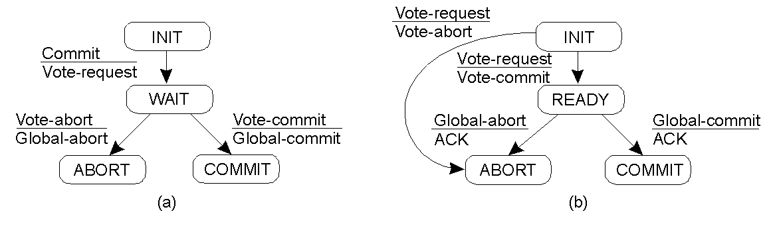

Two-Phase Commit (1)
✗
The finite state machine for the coordinator in 2PC.
The finite state machine for a participant.

Slide 53
Two-Phase Commit (2)
✗
The finite state machine for the coordinator in 2PC.
The finite state machine for a participant.

Slide 54
Two-Phase Commit (3)
State of Q | Action by P
COMMIT | Make transition to COMMIT
ABORT | Make transition to ABORT
INIT | Make transition to ABORT
READY | Contact another participant
Actions taken by a participant P when residing in state READY and having contacted another participant Q.

Slide 55
Two-Phase Commit (4)
actions by coordinator:
write START _2PC to local log; multicast VOTE_REQUEST to all participants; while not all votes have been collected { wait for any incoming vote; if timeout { write GLOBAL_ABORT to local log; multicast GLOBAL_ABORT to all participants; exit; } record vote; } if all participants sent VOTE_COMMIT and coordinator votes COMMIT{ write GLOBAL_COMMIT to local log; multicast GLOBAL_COMMIT to all participants; } else { write GLOBAL_ABORT to local log; multicast GLOBAL_ABORT to all participants; }
Outline of the steps taken by the coordinator in 2PC.

Slide 56
Two-Phase Commit (5)
actions by participant:
write INIT to local log; wait for VOTE_REQUEST from coordinator; if timeout { write VOTE_ABORT to local log; exit; } if participant votes COMMIT { write VOTE_COMMIT to local log; send VOTE_COMMIT to coordinator; wait for DECISION from coordinator; if timeout { multicast DECISION_REQUEST to other participants; wait until DECISION is received; /* remain blocked */ write DECISION to local log; } if DECISION == GLOBAL_COMMIT write GLOBAL_COMMIT to local log; else if DECISION == GLOBAL_ABORT write GLOBAL_ABORT to local log; } else { write VOTE_ABORT to local log; send VOTE ABORT to coordinator; }
Steps taken by participant process in 2PC.

Slide 57
Two-Phase Commit (6)
actions for handling decision requests: /* executed by separate thread */
while true { wait until any incoming DECISION_REQUEST is received; /* remain blocked */ read most recently recorded STATE from the local log; if STATE == GLOBAL_COMMIT send GLOBAL_COMMIT to requesting participant; else if STATE == INIT or STATE == GLOBAL_ABORT send GLOBAL_ABORT to requesting participant; else skip; /* participant remains blocked */
Steps taken by participant process for handling incoming decision requests.

Slide 58
Two-Phase Commit(7)
When all participants are in the ready states, no final decision can be reached
Two-phase commit is a blocking commit protocol

Slide 59
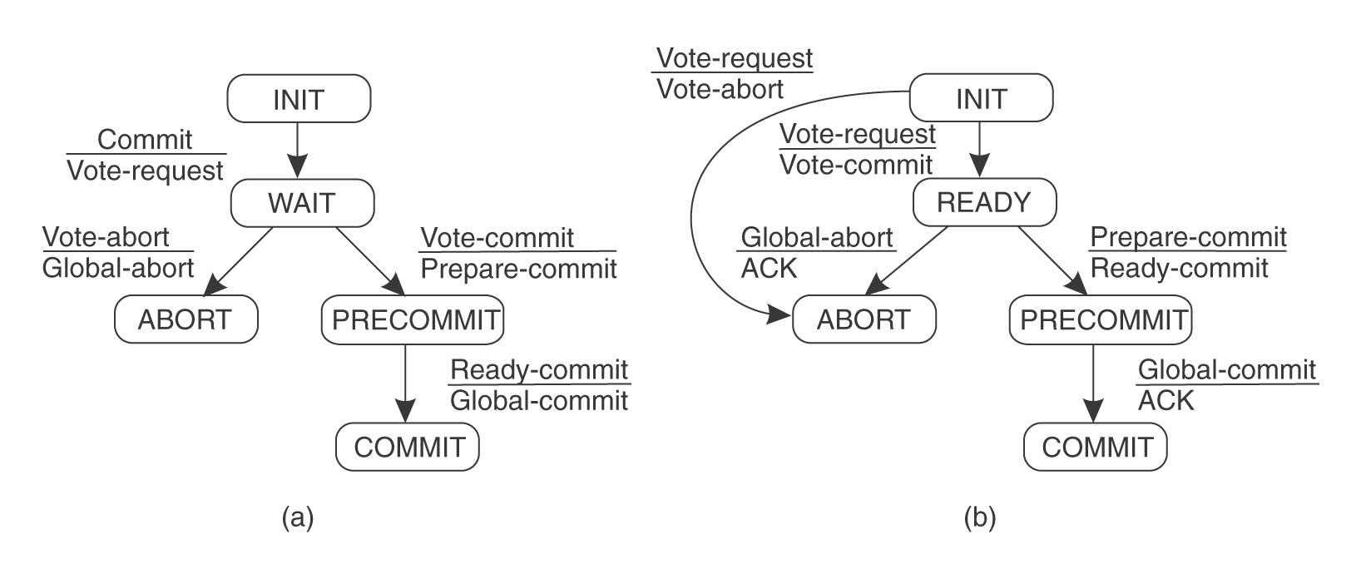
Three-Phase Commit (1)
There is no state from which a transition can be made to either Commit or Abort
There is no state where it is not possible to make a final decision and from which transition can be made to Commit
⇒ non-blocking commit protocol

Slide 60
Three-Phase Commit (2)
Coordinator sends Vote_Request (as before)
If all participants respond affirmatively,
Put Precommit state into log on stable storage
Send out Prepare_to_Commit message to all
After all participants acknowledge,
Put Commit state in log
Send out Global_Commit

Slide 61
Three-Phase Commit (3)
Coordinator blocked in Wait state
Safe to abort transaction
Coordinator blocked in Precommit state
Safe to issue Global_Commit
Any crashed or partitioned participants will commit when recovered

Slide 62
Three-Phase Commit (4)
Participant blocked in Precommit state
Contact others
Collectively decide to commit
Participant blocked in Ready state
Contact others
If any in Abort, then abort transaction
If any in Precommit, the move to Precommit state
If all in Ready state, then abort transaction

Slide 63
Fault Tolerance
Chapter 8
Part V
Recovery

Slide 64
Recovery
We’ve talked a lot about fault tolerance, but not about what happens after a fault has occurred
A process that exhibits a failure has to be able to recover to a correct state
There are two basic types of recovery:
Backward Recovery
Forward Recovery

Slide 65
Backward Recovery
The goal of backward recovery is to bring the system from an erroneous state back to a prior correct state
The state of the system must be recorded - checkpointed - from time to time, and then restored when things go wrong
Examples
Reliable communication through packet retransmission

Slide 66
Forward Recovery
The goal of forward recovery is to bring a system from an erroneous state to a correct new state (not a previous state)
Examples:
Reliable communication via erasure correction, such as an (n, k) block erasure code

Slide 67
More on Backward Recovery
Backward recovery is far more widely applied
The goal of backward recovery is to bring the system from an erroneous state back to a prior correct state
But, how to get a prior correct state?
Checkpointing
Checkpointing is costly, so it’s often combined with message logging

Slide 68
Stable Storage
In order to store checkpoints and logs, information needs to be stored safely - not just able to survive crashes, but also able to survive hardware faults
RAID is the typical example of stable storage

Slide 69
Checkpointing
Related to checkpointing, let us first discuss the global state and the distributed snapshot algorithm

Slide 70
Determining Global States
The global state of a distributed computation is
the set of local states of all individual processes involved in the computation
+
the states of the communication channels
How?

Slide 71
Obvious First Solution…
Synchronize clocks of all processes and ask all processes to record their states at known time t
Problems?
Time synchronization possible only approximately
distributed banking applications: no approximations!
Does not record the state of messages in the channels

Slide 72
Global State
We cannot determine the exact global state of the system, but we can record a snapshot of it
Distributed Snapshot: a state the system might have been in [Chandy and Lamport]

Slide 73
A naïve snapshot algorithm
Processes record their states at any arbitrary points
A designated process collects these states
+ So simple!!
- Correct??

Slide 74
Example Producer Consumer problem
p
q
m
p records its state

Slide 75
Example
p
q
m

Slide 76
Example
p
q
m
q records its state

Slide 77
Example The recorded state
p
q
m
m
The sender has no record of the sending
The receiver has the record of the receipt

Slide 78
What’s Wrong?
p
m
q
Result:
Global state has record of the receive event but no send event violating the happens-before concept!!

Slide 79
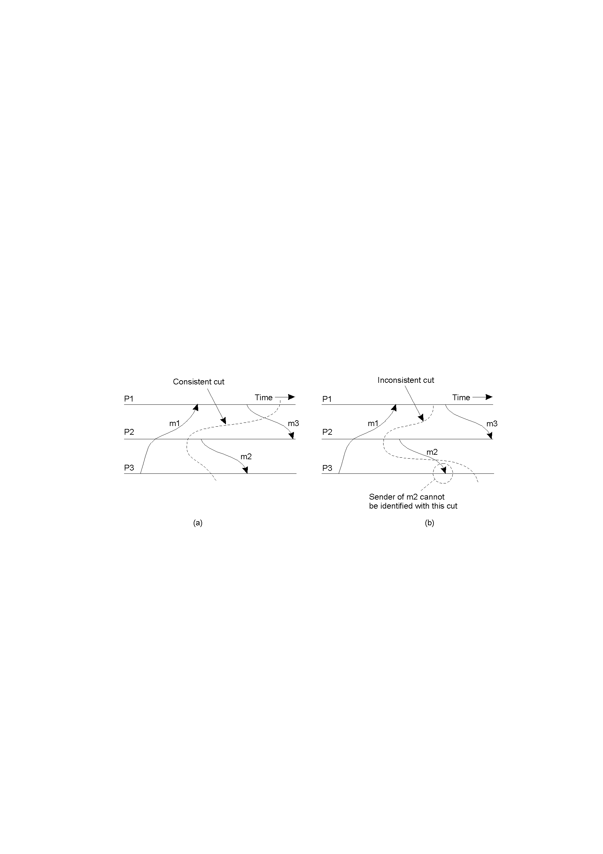
Cut
A consistent cut (meaningful global state) ?

Slide 80
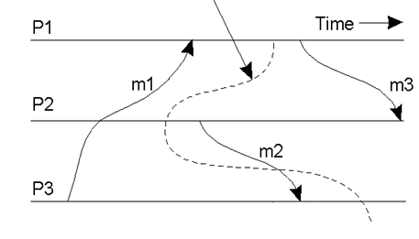
Cut
A consistent cut (meaningful global state) ?

Slide 81
Cuts
A consistent cut (meaningful global state)
An inconsistent cut

Slide 82
The “Snapshot” Algorithm
Records a set of process and channel states such that the combination is a consistent GS.
Assumptions:
All messages arrive intact, exactly once
Communication channels are unidirectional and FIFO-ordered
There is a comm. path between any two processes
Any process may initiate the snapshot (sends Marker)
Snapshot does not interfere with normal execution
Each process records its state and the state of its incoming channels

Slide 83
The “Snapshot” Algorithm (2)
1. Marker sending rule for initiator process P₀
After P₀ has recorded its state
for each outgoing channel C, sends a marker on C
2. Marker receiving rule for a process P_{k,} on receipt of a marker over channel C
if P_{k} has not yet recorded its state
records P_{k}’s state
records the state of C as “empty”
turns on recording of messages over other incoming channels
for each outgoing channel C, sends a marker on C
else
records the state of C as all the messages received over C since P_{k} saved its state

Slide 84
Snapshot Example
e₁⁰
e₁^{1,2}
e₁³
e₁⁴
e₁⁵
P1
M
M
a
M
e₂⁴
e₂⁵
M
P2
e₂⁰
e₂^{1,2,3}
M
M
b
P3
e₃⁰
e₃^{1,2,3}
e₃⁴
1- P1 initiates snapshot: records its state (S1); sends Markers to P2 & P3; turns on recording for channels C21 and C31
2- P2 receives Marker over C12, records its state (S2), sets state(C12) = {} sends Marker to P1 & P3; turns on recording for channel C32
3- P1 receives Marker over C21, sets state(C21) = {a}
4- P3 receives Marker over C13, records its state (S3), sets state(C13) = {} sends Marker to P1 & P2; turns on recording for channel C23
5- P2 receives Marker over C32, sets state(C32) = {b}
6- P3 receives Marker over C23, sets state(C23) = {}
7- P1 receives Marker over C31, sets state(C31) = {}

Slide 85
Snapshot Example
e₁⁰
e₁³
P1
a
e₂⁴
P2
e₂⁰
b
P3
e₃⁰

Slide 86
Distributed Snapshot Algorithm
When a process finishes local snapshot, it collects its local state (S and C) and sends it to the initiator of the distributed snapshot
The initiator can then analyze the state
One algorithm for distributed global snapshots, but it’s not particularly efficient for large systems

Slide 87
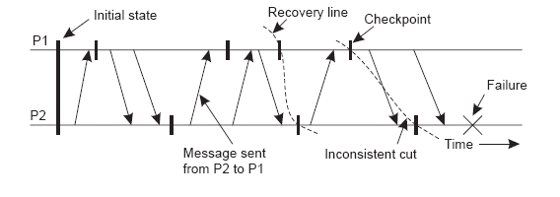
Checkpointing
We’ve discussed distributed snapshots
The most recent distributed snapshot in a system is also called the recovery line

Slide 88
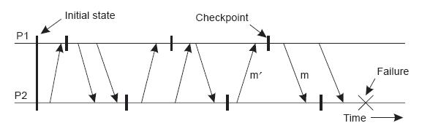
Independent Checkpointing
It is often difficult to find a recovery line in a system where every process just records its local state every so often - a domino effect or cascading rollback can result:

Slide 89
Coordinated Checkpointing
To solve this problem, systems can implement coordinated checkpointing
We’ve discussed one algorithm for distributed global snapshots, but it’s not particularly efficient for large systems
Another way to do it is to use a two-phase blocking protocol (with some coordinator) to get every process to checkpoint its local state “simultaneously”

Slide 90
Coordinated Checkpointing
Make sure that processes are synchronized when doing the checkpoint
Two-phase blocking protocol
Coordinator multicasts CHECKPOINT_REQUEST
Processes take local checkpoint
Delay further sends
Acknowledge to coordinator
Send state
Coordinator multicasts CHECKPOINT_DONE

Slide 91
Message Logging
Checkpointing is expensive - message logging allows the occurrences between checkpoints to be replayed, so that checkpoints don’t need to happen as frequently

Slide 92
Message Logging
We need to choose when to log messages
Message-logging schemes can be characterized as pessimistic or optimistic by how they deal with orphan processes
An orphan process is one that survives the crash of another process but has an inconsistent state after the other process recovers

Slide 93
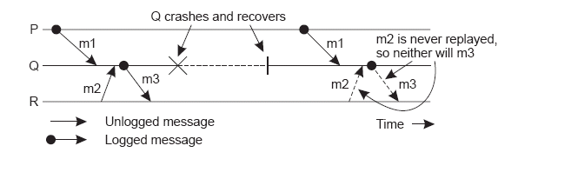
Message Logging
An example of an incorrect replay of messages

Slide 94
Message Logging
We assume that each message m has a header containing all the information necessary to retransmit m (sender, receiver, sequence no., etc.)
A message is called stable if it can no longer be lost - a stable message can be used for recovery by replaying its transmission

Slide 95
Message Logging
Each message m leads to a set of dependent processes DEP(m), to which either m or a message causally dependent on m has been delivered

Slide 96
Message Logging
The set COPY(m) consists of the processes that have a copy of m, but not in their local stable storage - any process in COPY(m) could deliver a copy of m on request

Slide 97
Message Logging
Process Q is an orphan process if there is a nonstable message m, such that Q is contained in DEP(m), and every process in COPY(m) has crashed

Slide 98
Message Logging
To avoid orphan processes, we need to ensure that if all processes in COPY(m) crash, no processes remain in DEP(m)

Slide 99
Pessimistic Logging
For each nonstable message m, ensure that at most one process P is dependent on m
The worst that can happen is that P crashes without m ever having been logged
No other process can have become dependent on m, because m was nonstable, so this leaves no orphans

Slide 100
Optimistic Logging
The work is done after a crash occurs, not before
If, for some m, each process in COPY(m) has crashed, then any orphan process in DEP(m) gets rolled back to a state in which it no longer belongs in DEP(m)

Slide 101
Optimistic Logging
The work is done after a crash occurs, not before
If, for some m, each process in COPY(m) has crashed, then any orphan process in DEP(m) gets rolled back to a state in which it no longer belongs in DEP(m)
Dependencies need to be explicitly tracked, which makes this difficult to implement - as a result, pessimistic approaches are preferred in real-world implementations

